Slide 1
Detector
Detector
Pin-Hole 1
Pin-Hole 1
LASER Source
LASER Source
Half Mirror
Half Mirror
Pin-Hole 2
Pin-Hole 2
Convex Lens
Convex Lens
Sample
Sample
Scanning
Scanning

Slide 2
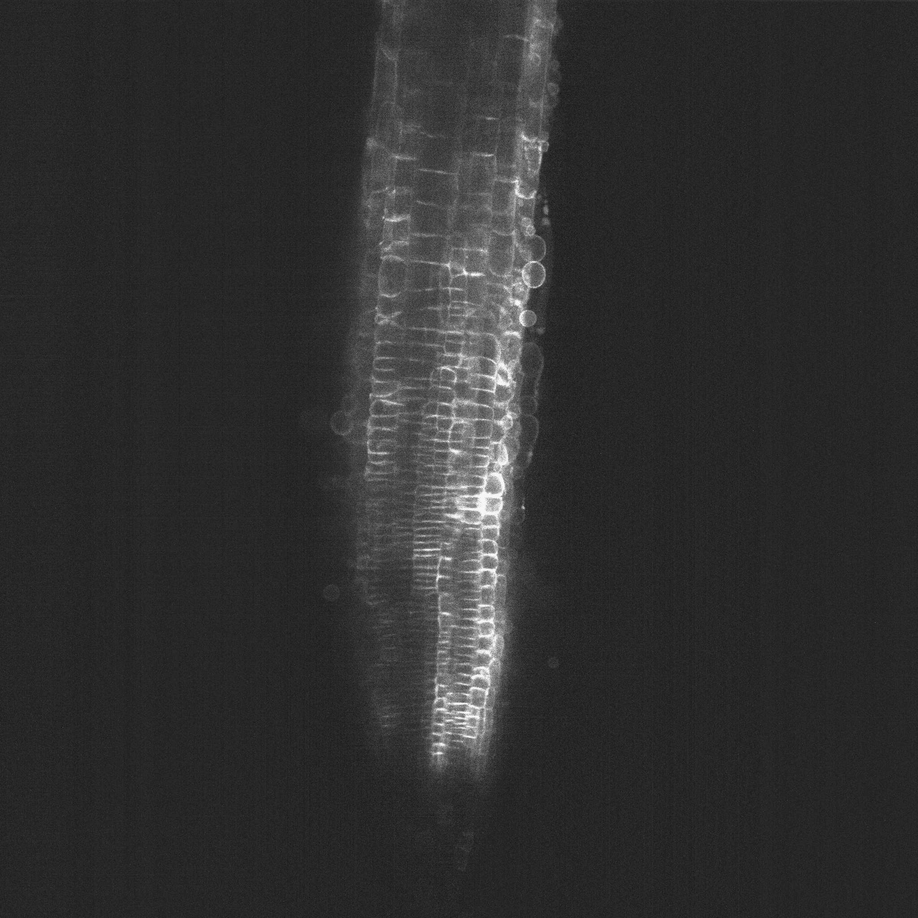







Slide 4
1. Predict
2. Matching
3. Update

